Slide 1


Team Members:
Nour Ahmed – Sandra Fares – Nour Elhode Hesham Mariam Hesham – Samiha Hesham
supervision by:
Dr: Islam Tharwat – Eng: Lobna Shahen

Slide 2

Software Design Document For Intelligent Surveillance System In Smart Cities
Notes:
Photo by Sean Pollock on Unsplash

Slide 3
Table of contents
Introduction and objectives
Problem definition
Diagrams
Dataset Description
Methodology
User Interface
Demo
Accomplishments

Slide 4

Introduction
Software Design Document presents the project ”Intelligent Surveillance System For Smart Cities” thoroughly. It illustrates the framework and system design architecture of the proposed system. Moreover, the document provides a fully detailed system overview and scope besides stating the main objective of the system. The SDD document is considered a significant guide for the project team members and for the customer to be fully aware of the project. Also, for the developers to improve and develop the system in the future.
Notes:
Photo by Sean Pollock on Unsplash

Slide 5
Problem Definition
One of the challenges that face surveillance systems in smart cities is Big data. Each camera records a massive amount of video and audio data to be processed. To handle such massive data, it is essential to provide a way to get real-time data processing analysis efficiently.

Slide 6
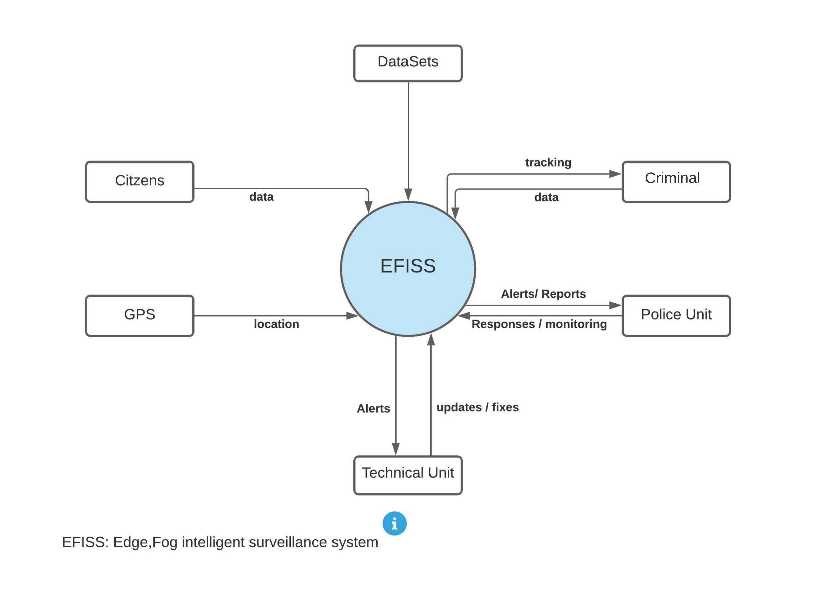
Context Diagram

Slide 7
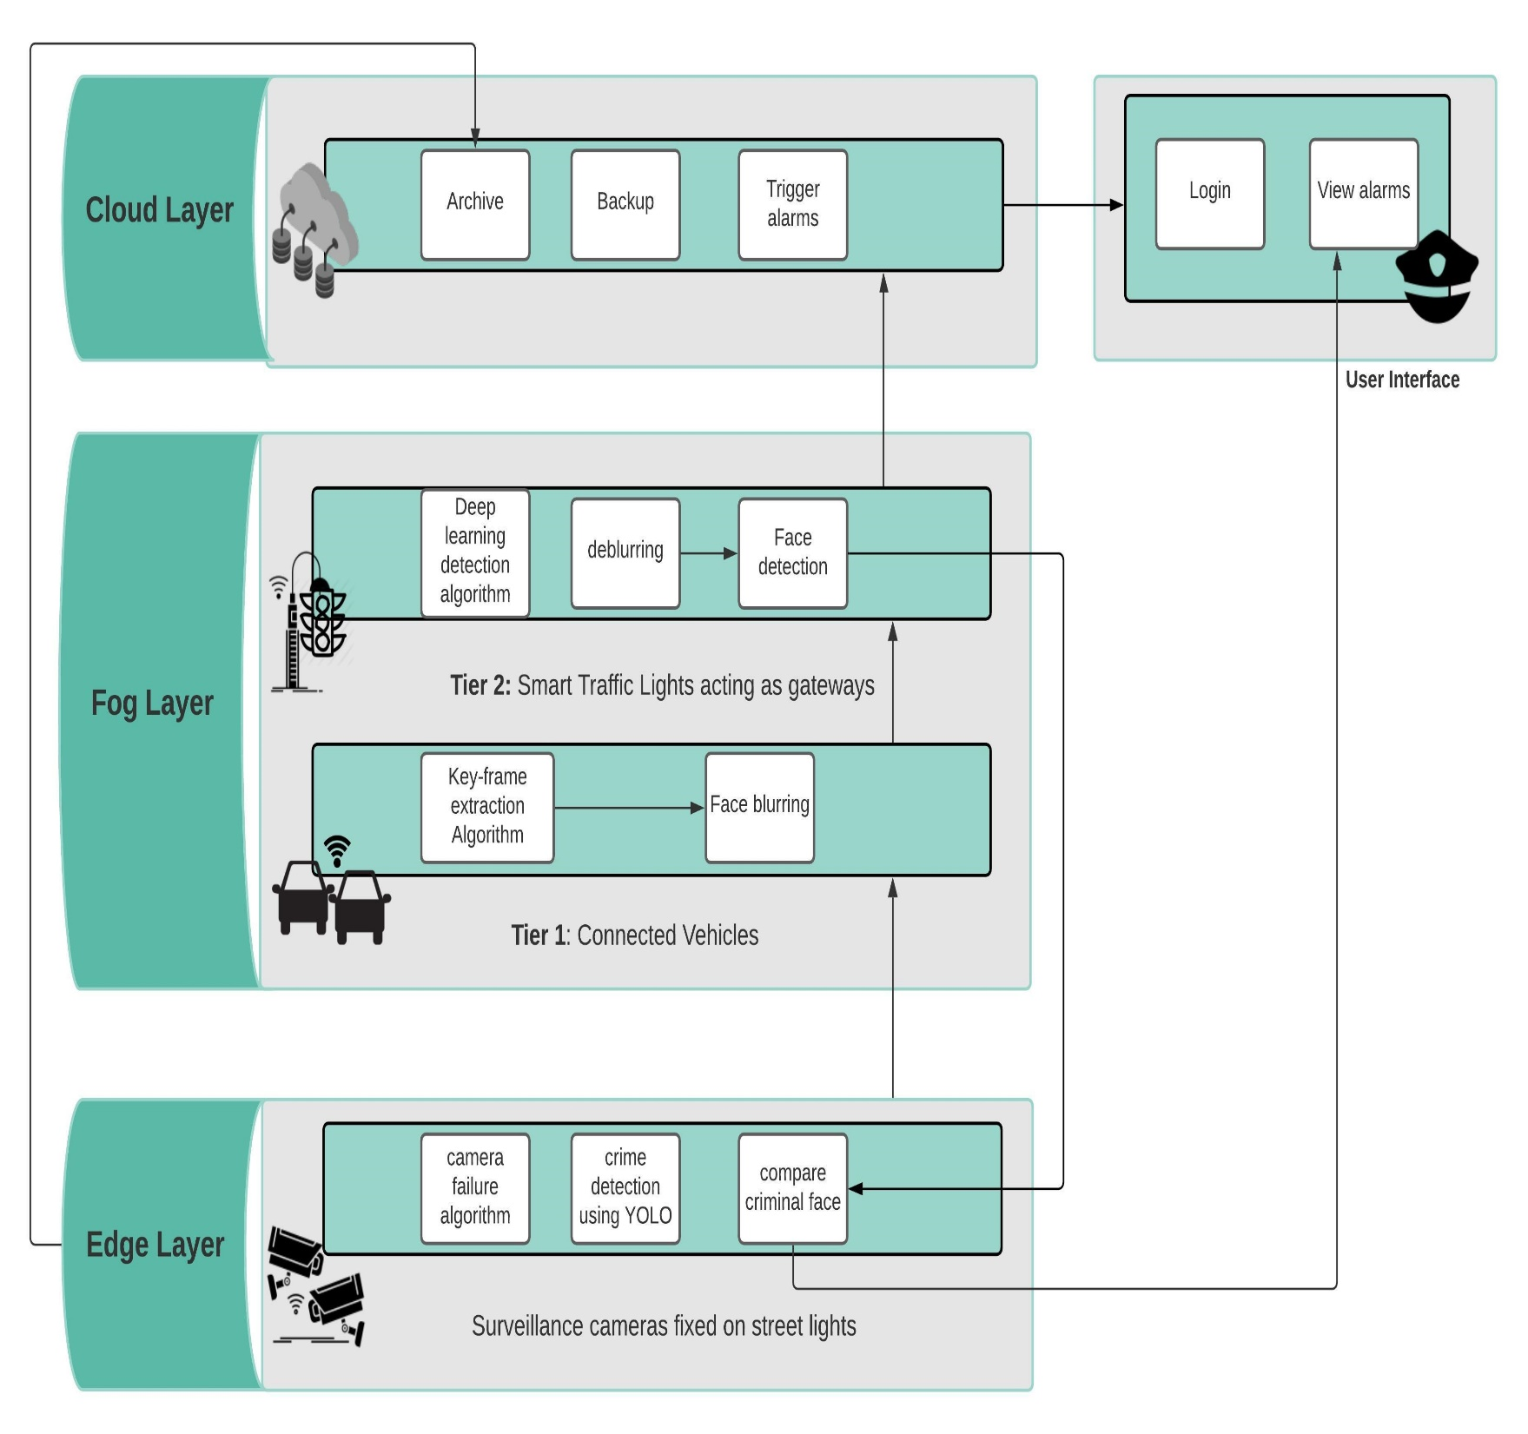
System Architecture

Slide 8
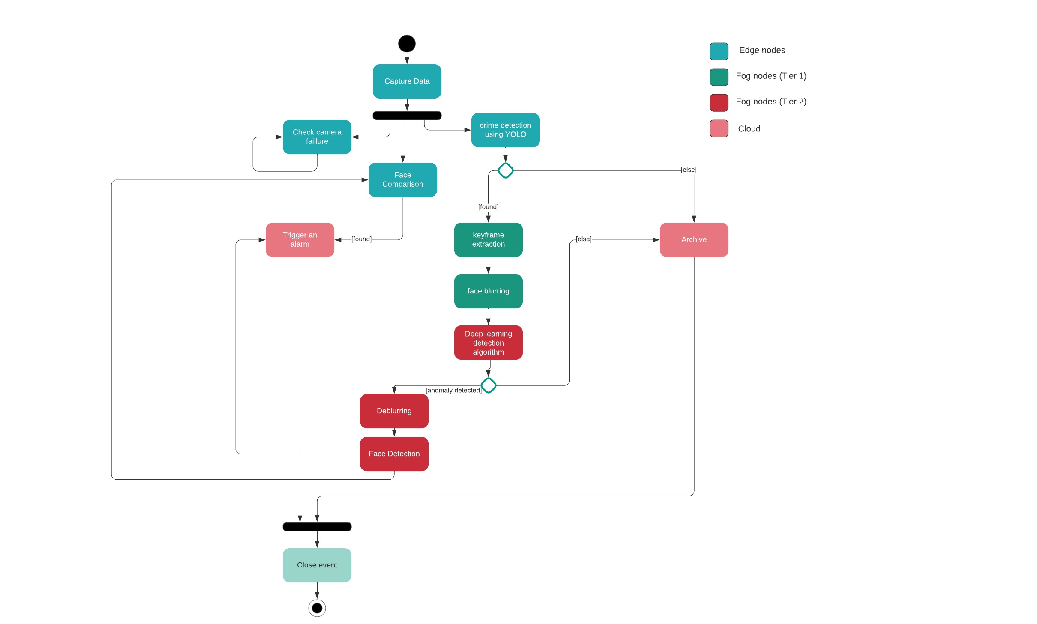
Activity Diagram

Slide 9
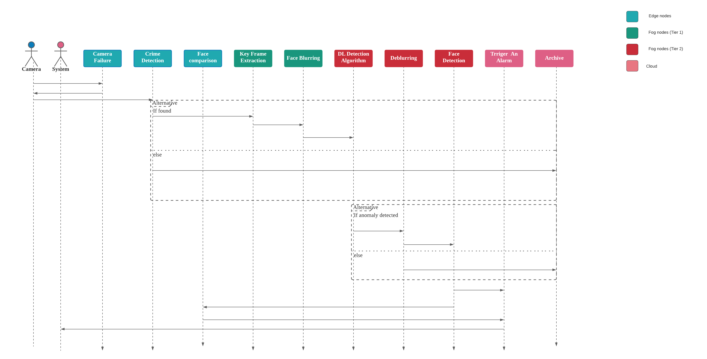
Sequence Diagram

Slide 10
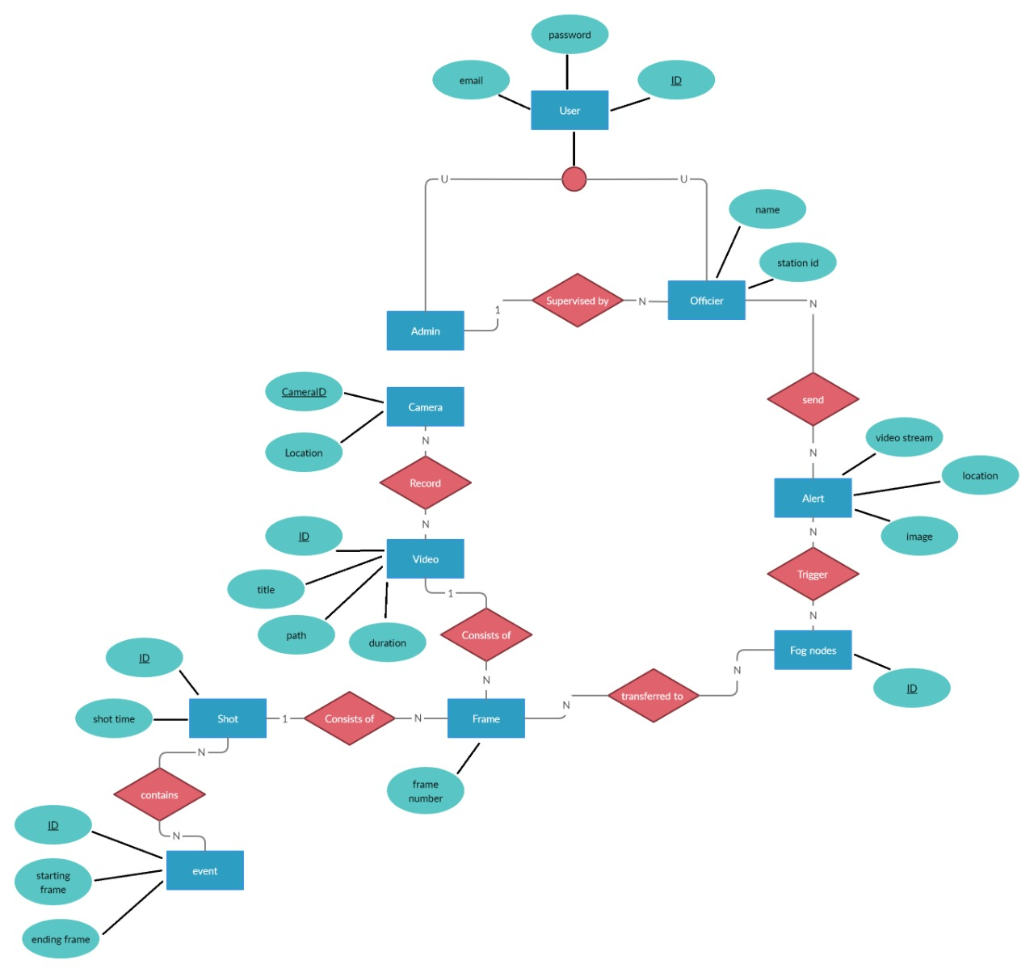
ER Diagram

Slide 11
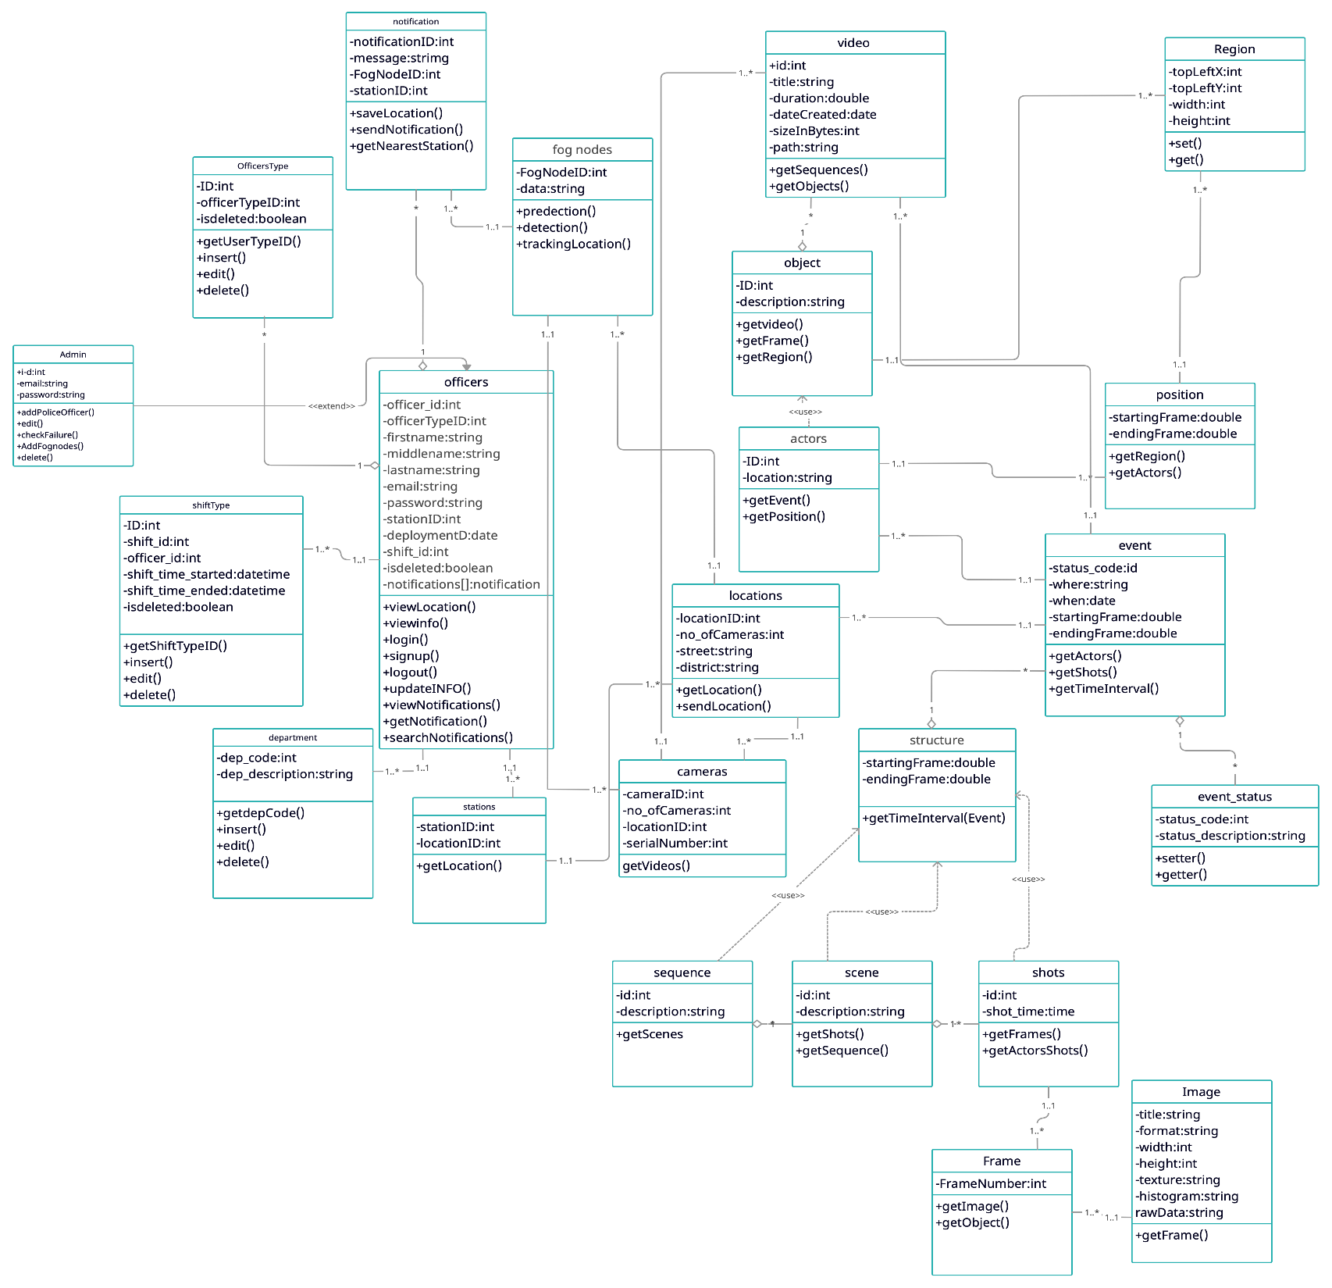
Class Diagram

Slide 12
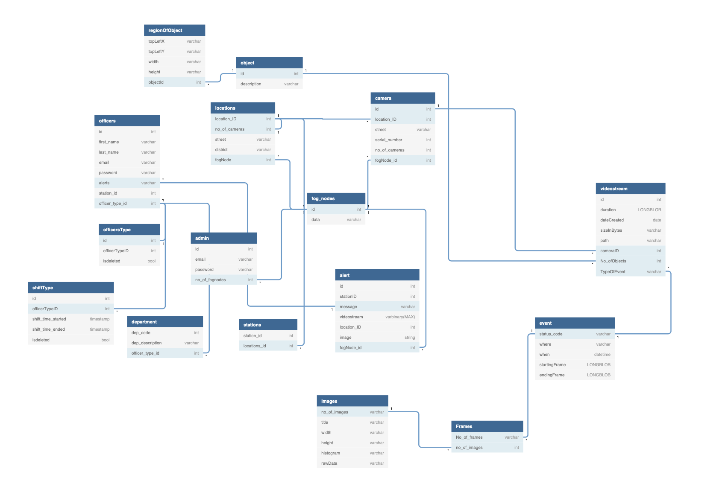
Database scheme

Slide 13

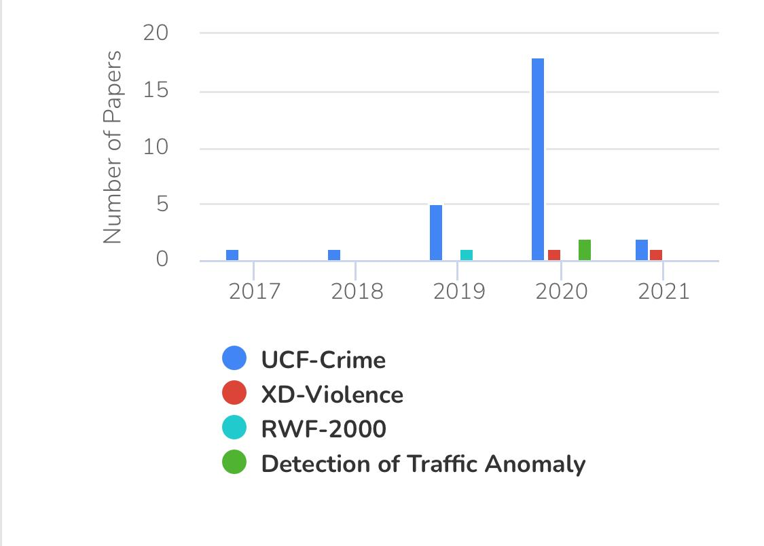
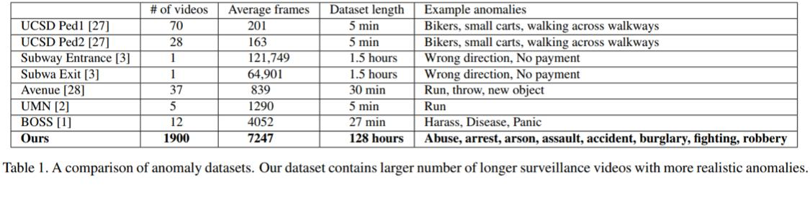
Dataset
Description
We have acquired a data set of surveillance videos published by the UCF Center for research in computer vision called UCF-Crime, it has1900 video of many classes as Robbery, Stealing, Shooting ... etc.
Notes:
Photo by Sean Pollock on Unsplash

Slide 14

Dataset
Description
Dataset Name
Dataset Size
UCF-Crime Datase
95.9 GB.
Dataset Link
Number Of Classes
https://www.crcv.ucf.edu/projects/real-world/
The dataset has 13 classes for anomaly events and normal class
Our Services
Average Video Frames
Number Of Videos Used
1000-1500 frames per video
we used for fighting 10 videos, Robbery 10 videos, normal events10 videos
Notes:
Photo by Sean Pollock on Unsplash

Slide 15
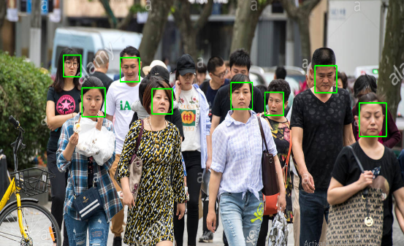
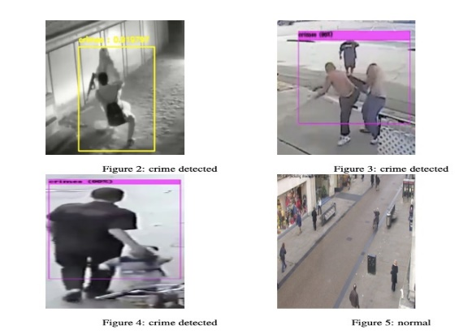
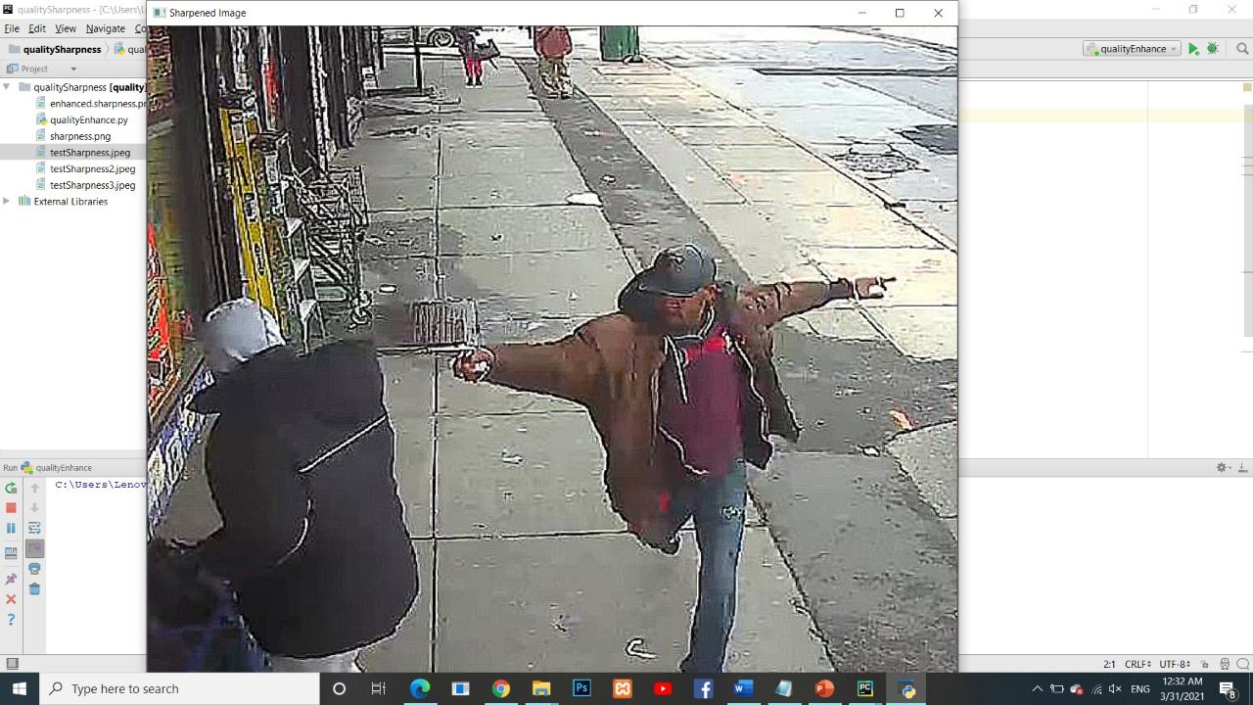
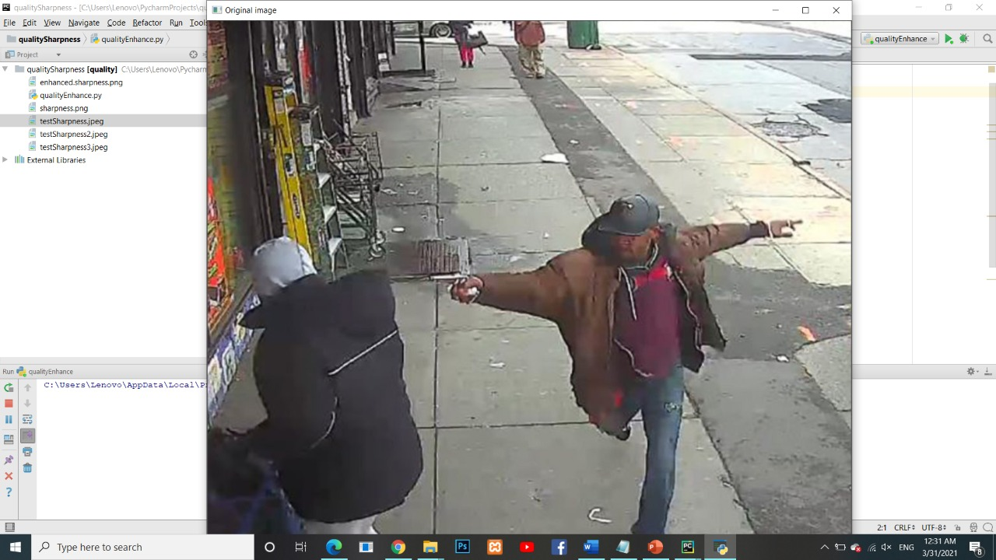
Methodology
Viola-Jones Algorithm
YOLOv4 Algorithm
Gaussian Noise Algorithm
It’s an Object Detection Framework, it’s utilized to detect faces in frames.
It’s A light weighted CNN model that utilized to detect objects.
An algorithm that improves and enhances the quality of the images.
Notes:
Photo by Sean Pollock on Unsplash

Slide 16
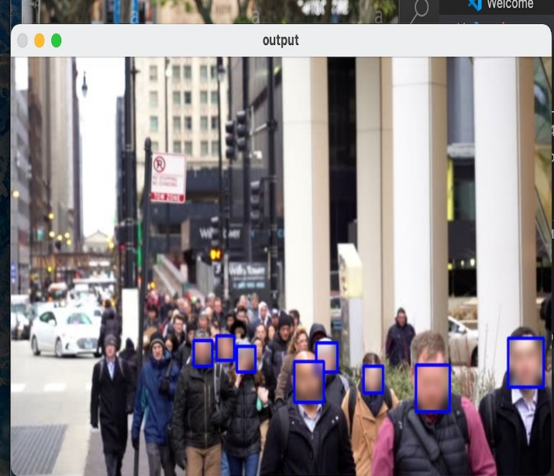
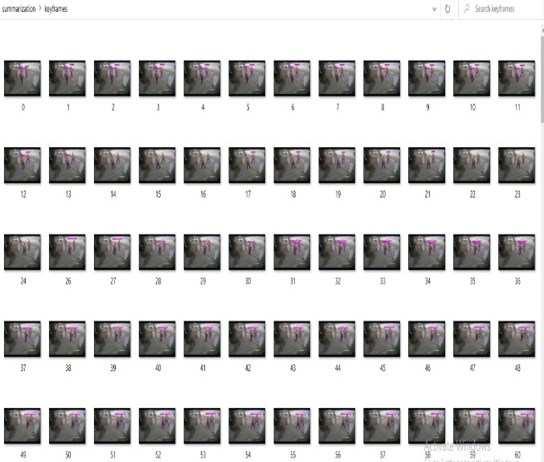
Methodology
Gaussian Blurring Algorithm
Key Frame Extraction
Cascade feature classifier for face detection is used then gaussian blur the faces
Extracting frame or set of frames that have a good representation of a shot.
Notes:
Photo by Sean Pollock on Unsplash

Slide 17
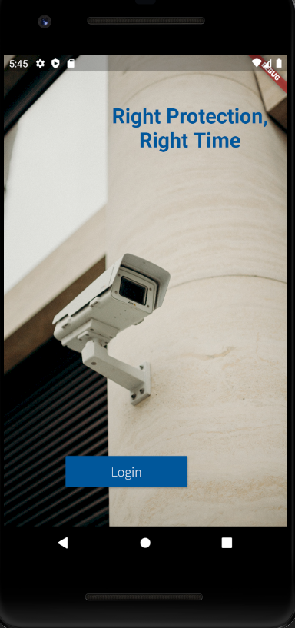

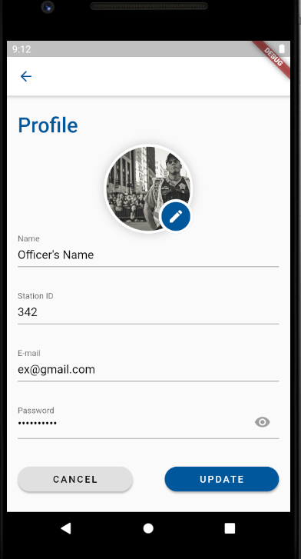
User Interface
Home
Login
Profile

Slide 18



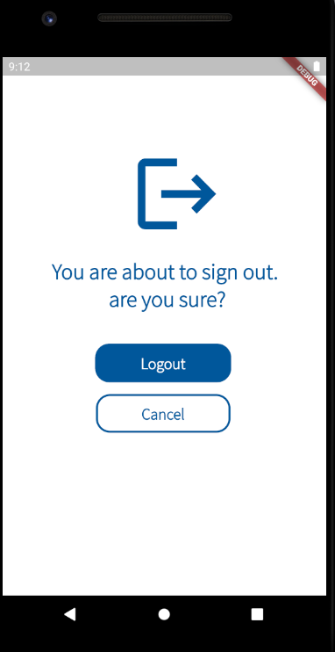
User Interface
Add Account
Alerts
Forget Password
Logout

Slide 19

Project Demo

Slide 20

Accomplishments
A systematic literature review 'Intelligent surveillance system for smart cities' paper with id 81 was presented in springer.
We are qualified for the second stage in dell competition.
We are on a pre-submission stage in IEEE with the paper 'Fog-based Architecture Design for Intelligent Surveillance systems: A Software Perspective '.
Notes:
Photo by Sean Pollock on Unsplash

Slide 21
Thank
You
Notes:
Photo by Sean Pollock on Unsplash

